Slide 1
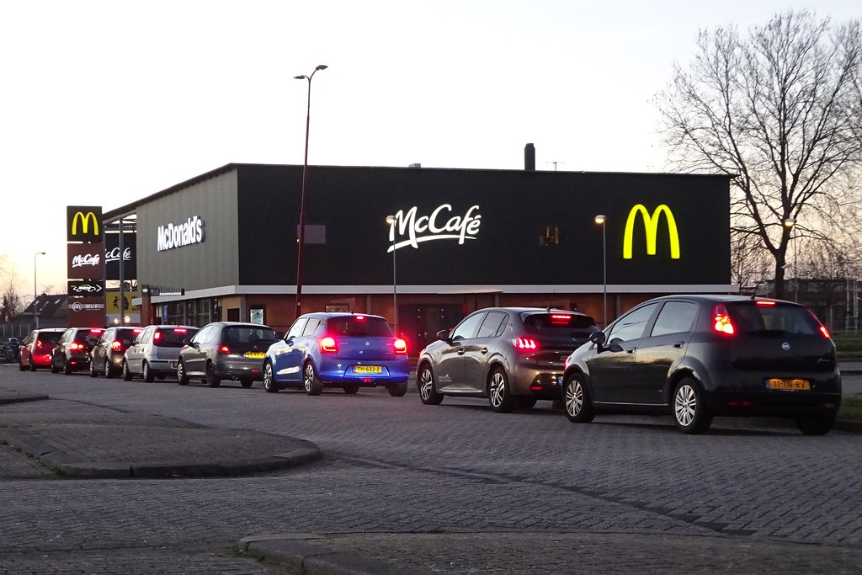
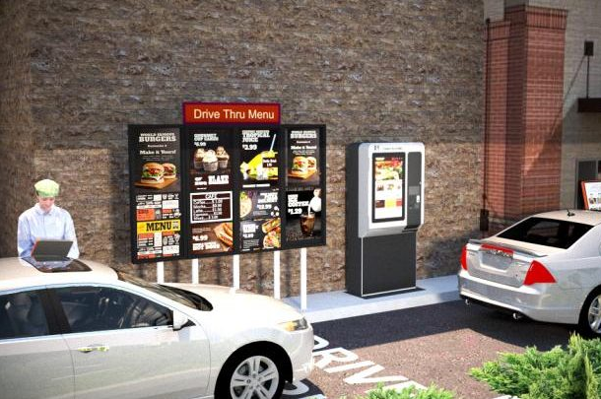
Food Surge Price Python Project
Project by Nick Seitz

Slide 2
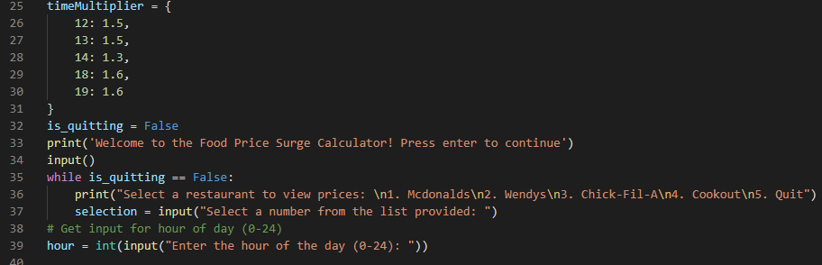
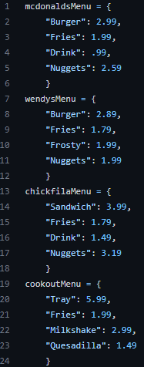
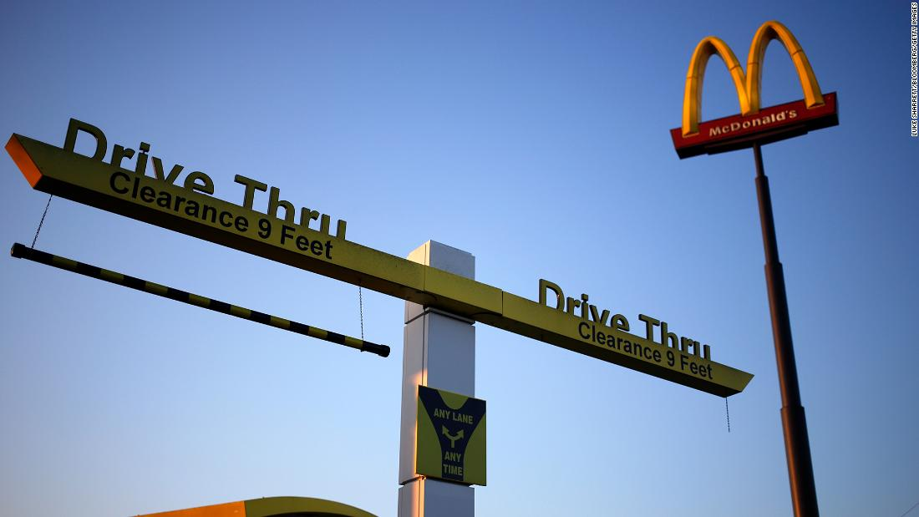
Food Price Surge
Project By: Nick Seitz
https://github.com/ksu-is/Food_PriceSurge/tree/main
My program allows users to anticipate food surge prices at their favorite restaurants based on where they go and what time they desire to go.
Here I implemented 4 different restaurants with menu items to choose from. The prices are not increased here
Here are some lines of code showing the process. When users open the program, they are met with a welcome message and options to choose from.
Information comes from compiling data of each restaurants busiest hours and increasing prices during those times by a predetermined percentage (ex. 4pm = 1.3% increase in menu items price)

